Slide 1
Loan Status Prediction
Machine Learning Project
Presenter : Vindyani K A C H

Slide 2



Background
INTRODUCTION
METHODOLOGY
RESULTS
ETHICS
CONCLUSION
Loan Applicants
Financial Company

Slide 3




Background
INTRODUCTION
METHODOLOGY
RESULTS
ETHICS
CONCLUSION

Slide 4


Background
INTRODUCTION
METHODOLOGY
RESULTS
ETHICS
CONCLUSION

Slide 5
Background
INTRODUCTION
METHODOLOGY
RESULTS
ETHICS
CONCLUSION
Loan Applicants
Financial Company

Slide 6



Background
INTRODUCTION
METHODOLOGY
RESULTS
ETHICS
CONCLUSION

Slide 7

Problem Statement
INTRODUCTION
Manual
METHODOLOGY
RESULTS
ETHICS
CONCLUSION
Automatic

Slide 8
Problem Statement
INTRODUCTION
METHODOLOGY
Manual
RESULTS
ETHICS
CONCLUSION
Automatic

Slide 9


Problem Statement
INTRODUCTION
METHODOLOGY
Manual
RESULTS
ETHICS
CONCLUSION
Automatic

Slide 10
Problem Statement
INTRODUCTION
METHODOLOGY
RESULTS
ETHICS
Automatic
CONCLUSION
Manual

Slide 11


Problem Statement
INTRODUCTION
METHODOLOGY
Automatic
RESULTS
ETHICS
CONCLUSION

Slide 12
Problem Statement
INTRODUCTION
METHODOLOGY
RESULTS
ETHICS
Automatic
CONCLUSION

Slide 13
Why is The Project important?
INTRODUCTION
METHODOLOGY
Loan Status Prediction Model | Manual Process
High Accuracy On Dataset | Subjected To Human Error
Quick And Automated | Time Consuming
Optimal Resource Allocation | Resource Consuming
Consistent Decisions | Varied Decisions
Transparent Decision Making | Limited Transparency
Can Handel Complex Patterns | May Struggle With Complexity
Cost Effective | Potentially High Cost
RESULTS
ETHICS
CONCLUSION

Slide 14
Project Goal
INTRODUCTION
Primary Goal
METHODOLOGY
“Develop robust, accurate, and effective machine learning models, for predicting loan statuses.”
RESULTS
Secondary Goal
ETHICS
“Deploy an accurate model to the financial sector for having an effective loan approval process.”
CONCLUSION

Slide 15
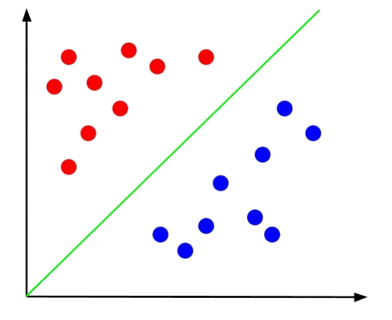
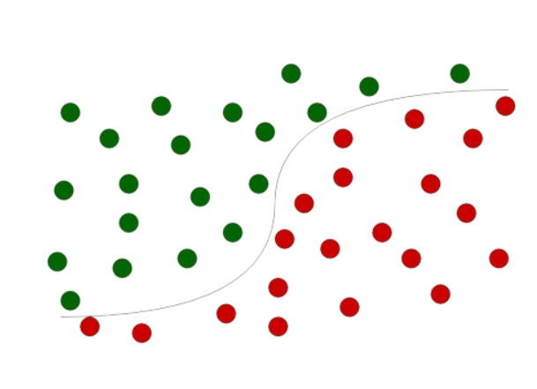
Algorithms
INTRODUCTION
METHODOLOGY
1. Logistic Regression
2. Support Vector Model
RESULTS
ETHICS
CONCLUSION

Slide 16
Algorithms
INTRODUCTION
Advantages
METHODOLOGY
Simplicity
Efficient with Small Datasets
Low Risk of Overfitting
Scalability
1. Logistic Regression
RESULTS
Disadvantages
ETHICS
Binary Classification Only
Not Robust to Irrelevant
Limited Handling of Missing Data
CONCLUSION

Slide 17
Algorithms
INTRODUCTION
METHODOLOGY
1. Logistic Regression
2. Support Vector Model
RESULTS
ETHICS
CONCLUSION

Slide 18
Algorithms
INTRODUCTION
Advantages
METHODOLOGY
Efficient with Small – Medium Size Datasets
Handles Non-Linear Decision Boundaries
Robust to Overfitting
2. Support Vector Model
RESULTS
Disadvantages
ETHICS
Computational Intensity
Memory Consumption
Not Well-Suited for Large Datasets
CONCLUSION

Slide 19
Description of Data
INTRODUCTION
Data Resource:
https://www.kaggle.com/datasets/zaurbegiev/my-dataset
Data Type:
Bank Loan Status Dataset
Used Features:
Current Loan Amount, Annual Income, Home Ownership, Purpose, Monthly Debt,
Years of Credit History, No of Credit Problems, Current Credit Balance, Bankruptcies, Tax Linens, Short Term
No. Data Points:
100514
Output Variable:
Fully Paid
METHODOLOGY
RESULTS
EPICS
CONCLUSION

Slide 20






Pre-processing Data
INTRODUCTION
METHODOLOGY
RESULTS
Describe Dataset
Dropping Columns
Checking NULL Values
EPICS
CONCLUSION
Pre-processed Dataset
Data Encoding
Filling Missing Values

Slide 21
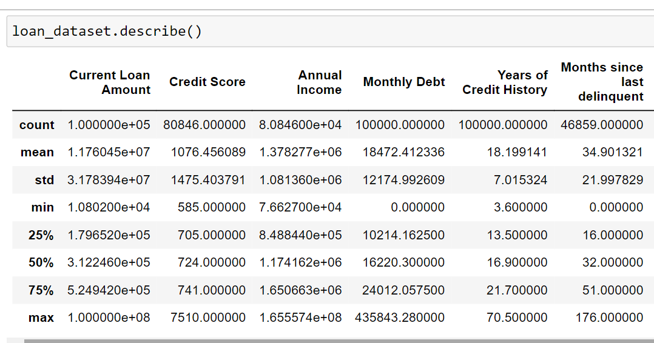
Pre-processing Data
INTRODUCTION
The mean value is used to fill the missing data without affecting to the dataset.
METHODOLOGY
RESULTS
EPICS
Describe Dataset
CONCLUSION

Slide 22
Pre-processing Data
INTRODUCTION
METHODOLOGY
RESULTS
Describe Dataset
Dropping Columns
Checking NULL Values
EPICS
CONCLUSION
Pre-processed Dataset
Data Encoding
Filling Missing Values

Slide 23
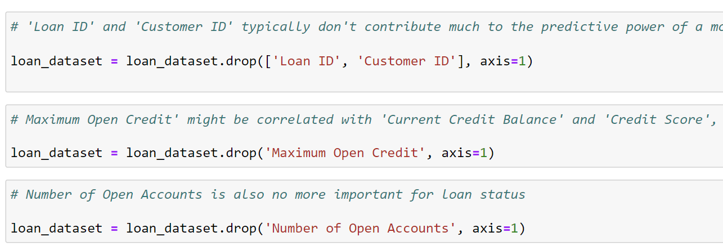
Pre-processing Data
INTRODUCTION
Unnecessary columns should be dropped.
METHODOLOGY
RESULTS
EPICS
Dropping Columns
CONCLUSION

Slide 24
Pre-processing Data
INTRODUCTION
METHODOLOGY
RESULTS
Describe Dataset
Dropping Columns
Checking NULL Values
EPICS
CONCLUSION
Pre-processed Dataset
Data Encoding
Filling Missing Values

Slide 25
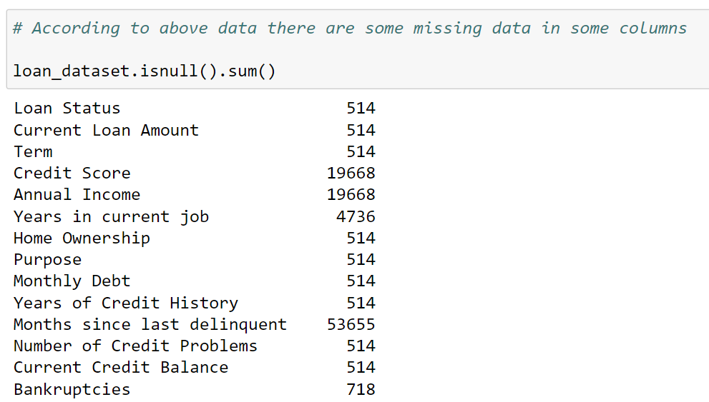
Pre-processing Data
INTRODUCTION
Checking how many null values are available in each column.
METHODOLOGY
RESULTS
EPICS
Checking NULL Values
CONCLUSION

Slide 26
Pre-processing Data
INTRODUCTION
METHODOLOGY
RESULTS
Describe Dataset
Dropping Columns
Checking NULL Values
EPICS
CONCLUSION
Pre-processed Dataset
Data Encoding
Filling Missing Values

Slide 27
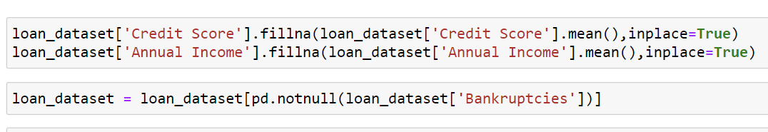
Pre-processing Data
INTRODUCTION
If the column is really important, according to the mean value missing values are filled.
METHODOLOGY
RESULTS
EPICS
Filling Missing Values
CONCLUSION

Slide 28
Pre-processing Data
INTRODUCTION
METHODOLOGY
RESULTS
Describe Dataset
Dropping Columns
Checking NULL Values
EPICS
CONCLUSION
Pre-processed Dataset
Data Encoding
Filling Missing Values

Slide 29
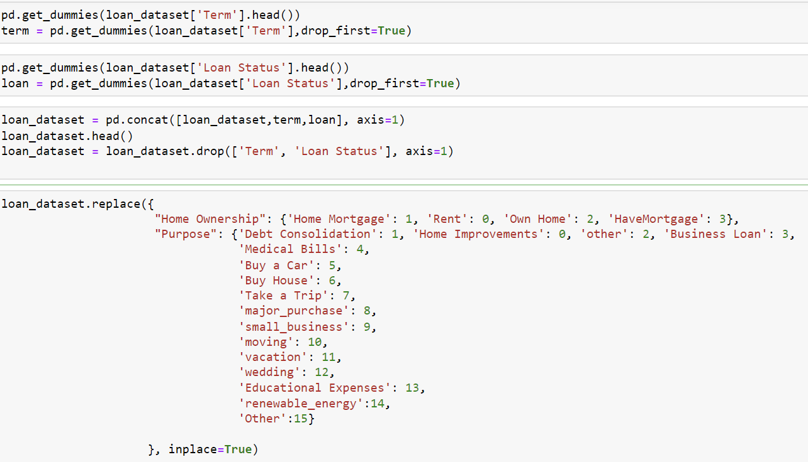
Pre-processing Data
INTRODUCTION
Converting Categorical data into Numerical Values.
METHODOLOGY
RESULTS
EPICS
Data Encoding
CONCLUSION

Slide 30
Pre-processing Data
INTRODUCTION
METHODOLOGY
RESULTS
Describe Dataset
Dropping Columns
Checking NULL Values
EPICS
CONCLUSION
Pre-processed Dataset
Data Encoding
Filling Missing Values

Slide 31
Pre-processing Data
INTRODUCTION
METHODOLOGY
RESULTS
Pre-processed Dataset
EPICS
CONCLUSION
Test Data
20%
Train Data
80%

Slide 32
Model Evaluation Technique
INTRODUCTION
K-Fold Cross-Validation
METHODOLOGY
Cross-validation is a technique used in machine learning to check how well a model can generalize to new, or unseen data.
RESULTS
EPICS
CONCLUSION
Testing Data
Training Data

Slide 33
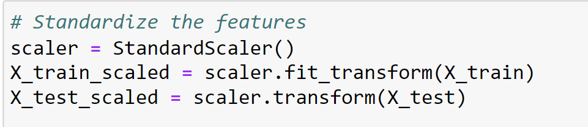
Implementation Description
INTRODUCTION
Resource for Code:
https://youtu.be/XckM1pFgZmg?si=BkwN6V4rxB_Ic9Q_
Modifications:
SVM was trained using standardized data for better accuracy.
METHODOLOGY
RESULTS
EPICS
CONCLUSION

Slide 34
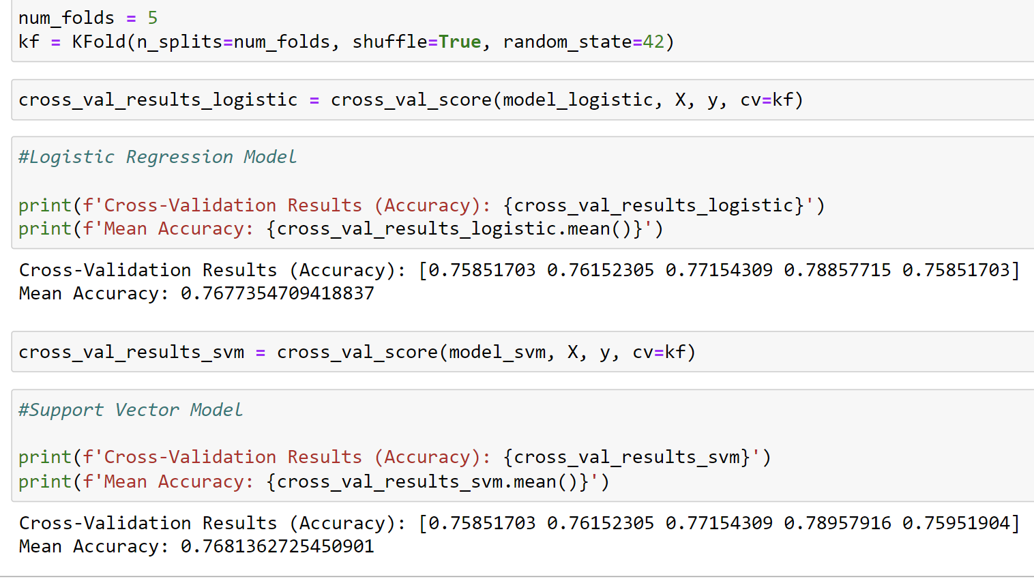
Implementation Description
INTRODUCTION
Modifications:
Add K-Fold Cross-Validation Technique for Better Accuracy
METHODOLOGY
RESULTS
EPICS
CONCLUSION

Slide 35
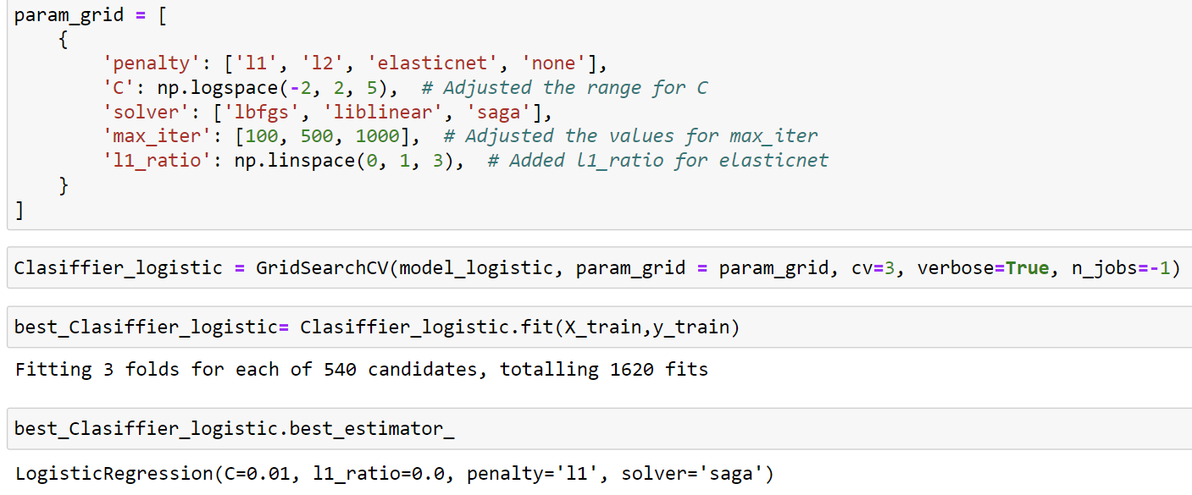
Implementation Description
INTRODUCTION
Modifications:
Add Hyperparameter Tunning
METHODOLOGY
RESULTS
EPICS
CONCLUSION

Slide 36
Implementation Description
INTRODUCTION
Parameters:
Kernal Function
Regularization Parameter
Tolerance to Convergence
Class Weight
Penalty
Solver
Multi-class Handling
METHODOLOGY
RESULTS
Variable
EPICS
CONCLUSION
Fixed

Slide 37
Key Results
INTRODUCTION
Comparison of Models
METHODOLOGY
Model | Tuning | Class | Precision | Recall | F1-Score | Support | Accuracy
Logistic Regression | Before | True | 0.77 | 1.00 | 0.87 | 767 | 0.77
 | After | True | 0.78 | 0.60 | 0.68 | 767 | 0.56
SVM | Before | True | 0.78 | 0.60 | 0.68 | 767 | 0.56
 | After | True | 0.78 | 0.60 | 0.68 | 767 | 0.56
RESULTS
EPICS
Decision-Making
Both Models Predict in a Similar Way. (75+%)
CONCLUSION
Limitations
Still the system can have 20% wrong predictions.
There can be misclassified portions of the dataset.

Slide 38
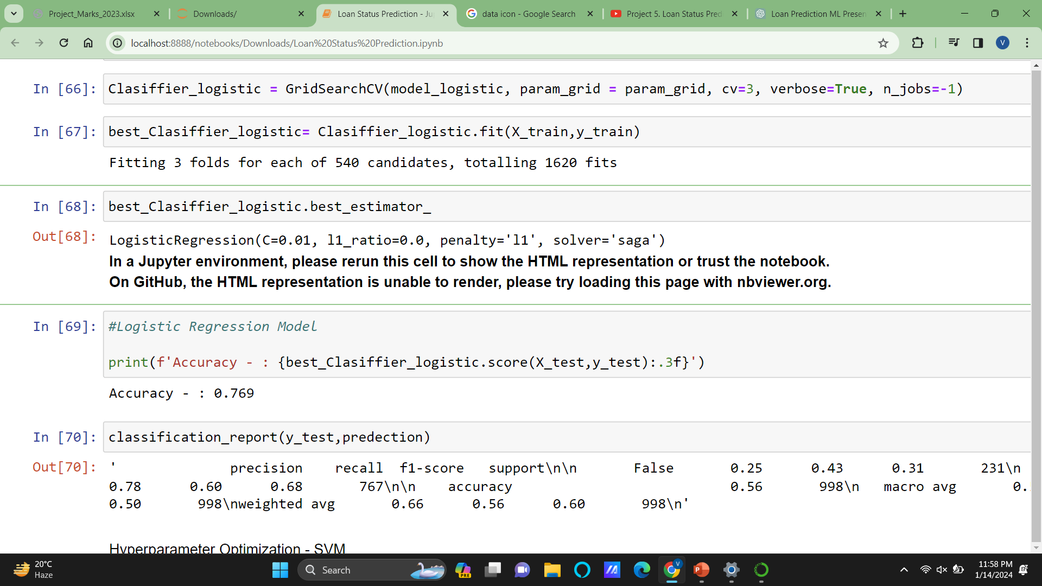
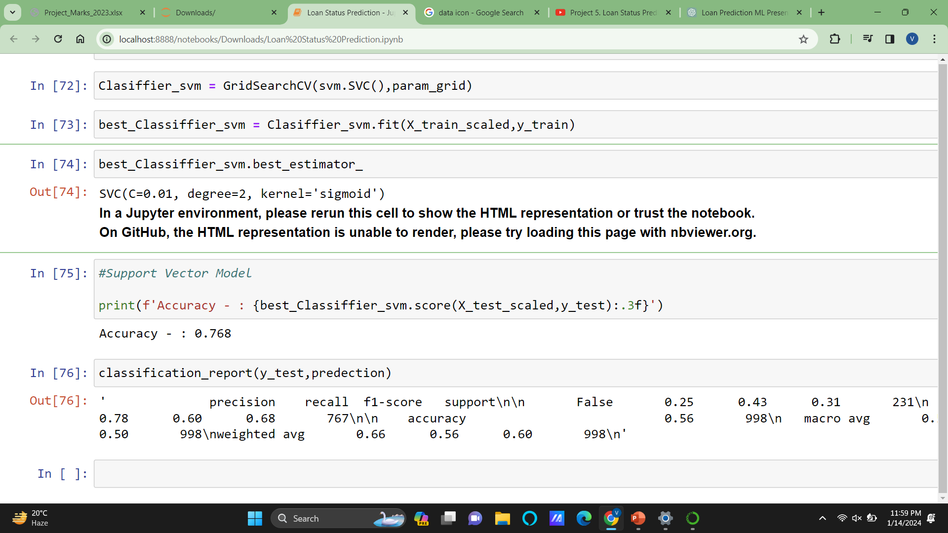
Outcomes with Project’s Goals
INTRODUCTION
METHODOLOGY
Primary Goal
Secondary Goal
“Develop robust, accurate, and effective ML models, for predicting loan statuses.”
“Deploy an accurate model to the financial sector for having effective loan approval processes.”
RESULTS
EPICS
CONCLUSION

Slide 39

Outcomes with Project’s Goals
INTRODUCTION
METHODOLOGY
Primary Goal
Secondary Goal
“Develop robust, accurate, and effective ML models, for predicting loan statuses.”
“Deploy an accurate model to the financial sector for having effective loan approval processes.”
RESULTS
EPICS
These models can increase the effectiveness of lending institutions
CONCLUSION

Slide 40
Outcomes with Project’s Goals
INTRODUCTION
METHODOLOGY
Primary Goal
Secondary Goal
“Develop robust, accurate, and effective ML models, for predicting loan statuses.”
“Deploy an accurate model to the financial sector for having effective loan approval processes.”
RESULTS
EPICS
These models can increase the effectiveness of lending institutions
CONCLUSION

Slide 41
Accuracy of The Models
INTRODUCTION
METHODOLOGY
RESULTS
EPICS
CONCLUSION

Slide 42
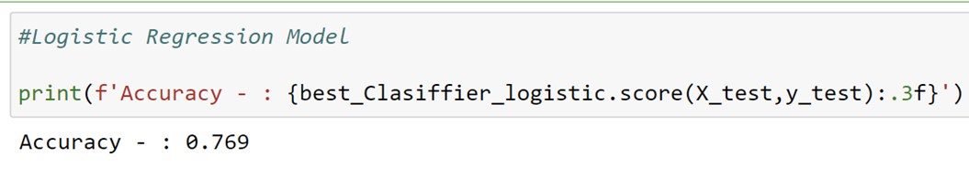
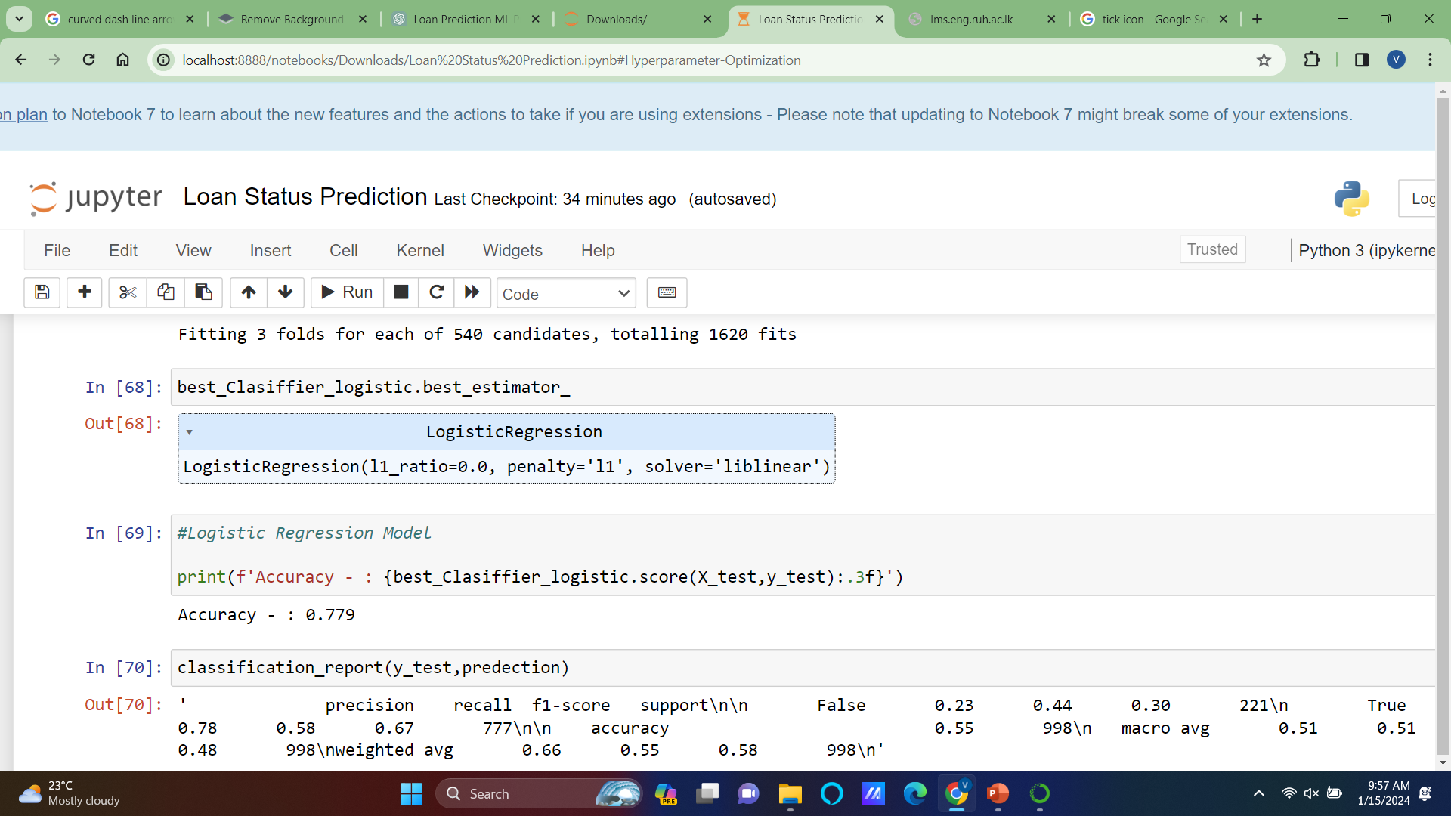
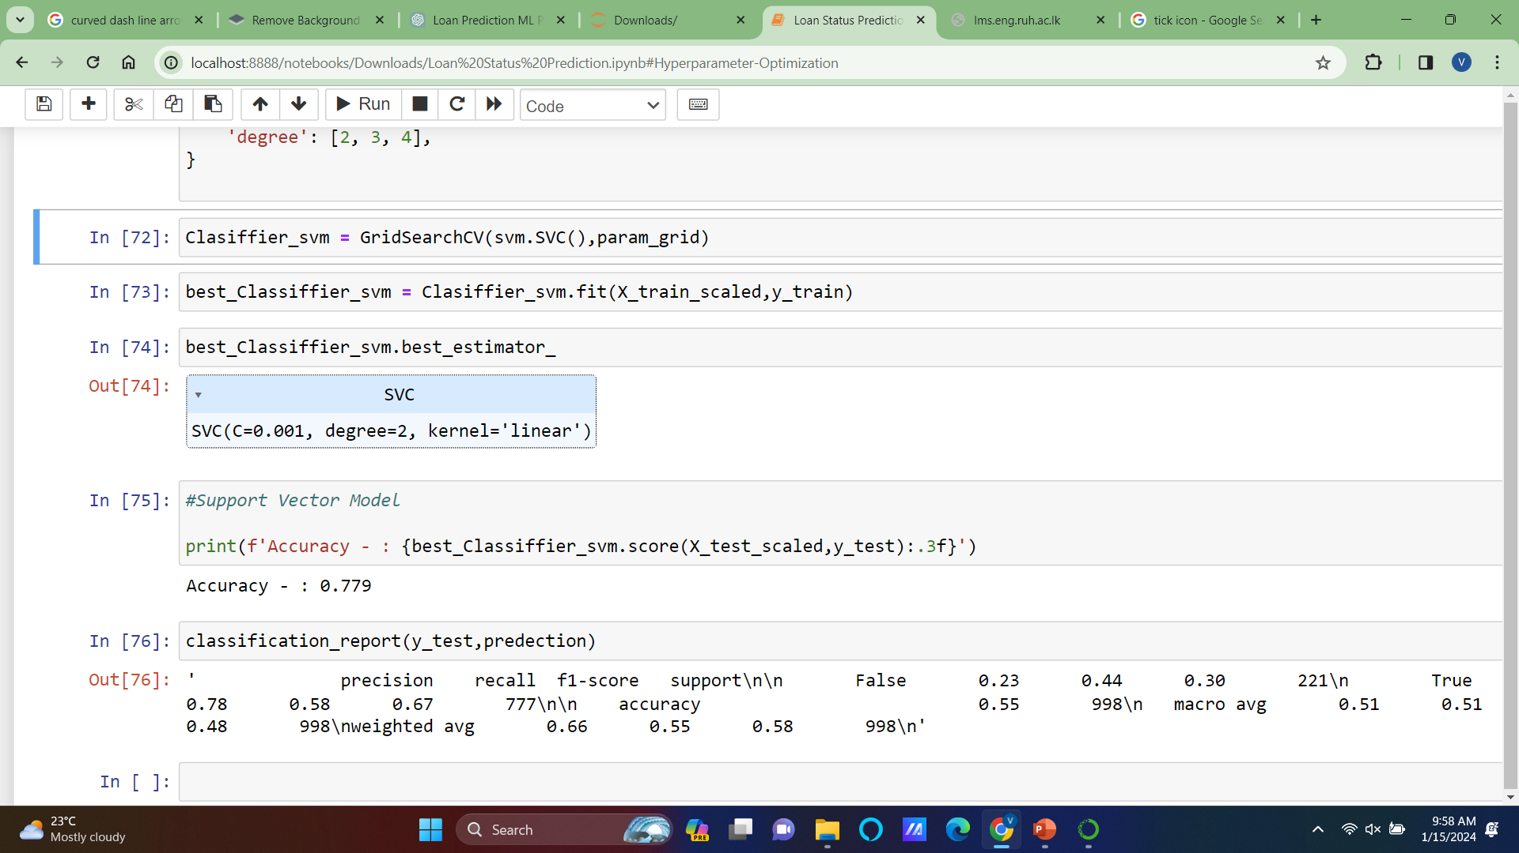
Suitability of The Models
INTRODUCTION
There is a consistent performance in both models.
METHODOLOGY
Linear Regression
Support Vector Model
RESULTS
EPICS
After Reloading the Kernel
CONCLUSION

Slide 43
Ethical Aspects
INTRODUCTION
METHODOLOGY
Ethical Aspects
RESULTS
EPICS
Data Bias
and
Fairness
Transparency and Explainability
Privacy Concerns
CONCLUSION

Slide 44
Ethical Aspects
INTRODUCTION
Data Bias
and
Fairness
METHODOLOGY
RESULTS
Issue
Recognize that biased models may produce discriminating results if they are based on biased data.
Mitigation
Talk about the steps done to find and reduce biases in the dataset and any fairness-aware modeling strategies that were used.
EPICS
CONCLUSION

Slide 45
Ethical Aspects
INTRODUCTION
METHODOLOGY
Ethical Aspects
RESULTS
EPICS
Data Bias
and
Fairness
Transparency and Explainability
Privacy Concerns
CONCLUSION

Slide 46
Ethical Aspects
INTRODUCTION
Transparency and Explainability
METHODOLOGY
RESULTS
Issue
Transparency issues arise from the potential lack of interpretability of complicated models such as SVM.
Mitigation
Better to take action like feature importance analysis, and convey the trade-offs between interpretability and model complexity.
EPICS
CONCLUSION

Slide 47
Ethical Aspects
INTRODUCTION
METHODOLOGY
Ethical Aspects
RESULTS
EPICS
Data Bias
and
Fairness
Transparency and Explainability
Privacy Concerns
CONCLUSION

Slide 48
Ethical Aspects
INTRODUCTION
Privacy Concerns
METHODOLOGY
RESULTS
Issue
Recognize the importance of handling sensitive customer information responsibly.
Mitigation
Guarantee compliance with data protection rules, and anonymize or pseudonymize data.
EPICS
CONCLUSION

Slide 49
Conclusion
INTRODUCTION
“In closing, our journey in predicting loan statuses using machine learning has been both insightful and impactful. Our models, primarily Logistic Regression and SVM, exhibit promising accuracy, but we acknowledge the importance of continuous improvement.
We've addressed key ethical considerations, ensuring fairness, transparency, and privacy. As we move forward, our commitment remains steadfast – to refine, innovate, and contribute to a responsible and effective lending environment. ”
METHODOLOGY
RESULTS
EPICS
CONCLUSION

Slide 50
Thank You
INTRODUCTION
METHODOLOGY
RESULTS
EPICS
CONCLUSION

